Slide 1
Introduction about OLO Membership Services

Slide 2
About OLO
OLO is an e-commerce platform providing integrated services for global logistics enterprises, relying on vast global logistics enterprise cooperation alliance, building intelligent and efficient online marketing promotion and acquiring customers platform, establishing safe and convenient global payment and settlement system, through the industry big data analysis and accurate portraits to build global logistics enterprise credit system. OLO aims to provide full services for global logistics enterprise, by means of marketing promotion, online acquiring customers, agents developing, cooperation guarantee, payment settlement, global conference etc. With continuous innovation and “sincerity” services to promote the industrial development and help the growth of enterprises.

Slide 3
Product Overview
Relying on the website（www.olofamily.com), OLO membership provides global network establishment, business matching, transaction tracking, cooperative guarantee and other services for global logistics enterprises, and provides comprehensive online services in full process of the transaction, escorting the global business for logistics enterprises.
Service Object of the Product
Aim at small and medium-sized global freight forwarding enterprises that are willing to expand their global business without overseas branches or imperfect overseas network.

Slide 4
Solve the main problems
1
Finding overseas cooperation, high cost of visiting and following up customers.
2
Worry about the risk of bad debts in international business cooperation.
3
Suffering from foreign language level can not meet the requests when discussing with overseas agents.
4
Intend to obtain the new overseas nomination cargo resources.

Slide 5
Introduction of Product Value
Value Point | Main Items | Details
Trade Assurance | Guarantee within OLO | Enjoy trade assurance service top to USD100,000 offered by OLO Family
 | Guarantee outside OLO | Enjoy trade assurance service top to USD5000 if you cooperate with the organization accepted by OLO Family
Brand Promotion | Online advertising | Provide online advertisement to promote online and make you well-known
 |  | Promote on homepage and OLO members list
 | E-mail promotion | Recommend you to all OLO members by global promotion and email marketing. 2times/year
Develop Overseas Agents | Global forwarders | Obtain global forwarders list and resources with full contact details
 | Post information online | Post and receive cargo leads, agency request info with full contact details
 |  | Post enterprise news, manage and update the showroom
 | Agents recommend & Business matching | Recommend you with excellent agencies that best suit your needs;Recommend overseas agencies’ needs to you
Services Privilege | Priority ranking | Enjoy priority of ranking on the top of company directory always
 | Disputes mediating | In case of any disputes happened with other enterprises, OLO staffs will be willing to help and mediate.
 | One-to-one customer service | Provide one-to-one customer service to help you at any time
Value-Added Services | Conference discount price | Attend annual conference launched by OLO Famiy with lowest registration fee

Slide 6
Founding Member Benefits
The first 100 logistics enterprises will become the founding members of OLO which will enjoy below privileges ：
Privileges | Preferential content | Privilege details
First year purchase privilege | Discount for first year OLO Member | The purchase of a founding member is 5.6 discount off the normal price of a membership product
 | Discount for first meeting participation | Founding members enjoy the benefits of participating the 1st global logistics cooperation conference at the accompanying price（Ningbo conference）
Enjoy VIP membership privileges | Founding members page | The introduction will be displayed on the founding members page，The link to the founding members page is shown on the homepage；
 | Founder member identification | Identification and logo of the founding members will be displayed on the website and the conference;
 | Exclusive badge | Founding member badges will be awarded（Founding member badges will be awarded at first conference）
 | Distinguished guests seat | Exclusive founding member seat with VIP privileges at opening ceremony an gala dinner；
Membership renew privileges | Membership renew discount price | Membership product renewal enjoy 15% off（Membership expiring not exceed 1 year） ；
 | Conference discount price | 10% discount at second conference and all subsequent conference；If the company also has a promotion policy, you could enjoy both discount.

Slide 7
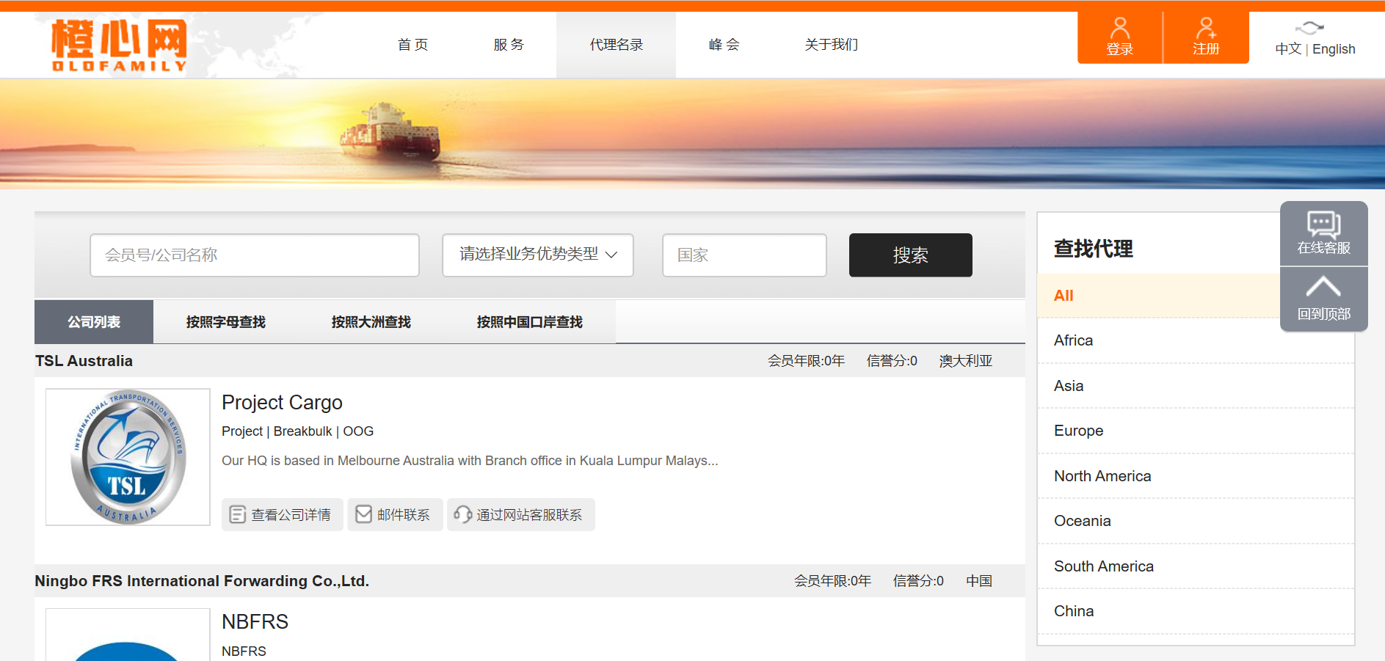
Service Highlights
1) Massive overseas agent resources： Gather domestic and foreign well-known freight forwarding enterprises, quickly lock the cooperation object
Can view the mass overseas enterprise contact information, overseas cooperation inquiries, at the same time, OLO has the following advantages ：
-- Professional overseas operations specialist for each region
-- It covers thousands of ports all over the world
-- Save cost, save a lot of upfront communication cost

Slide 8
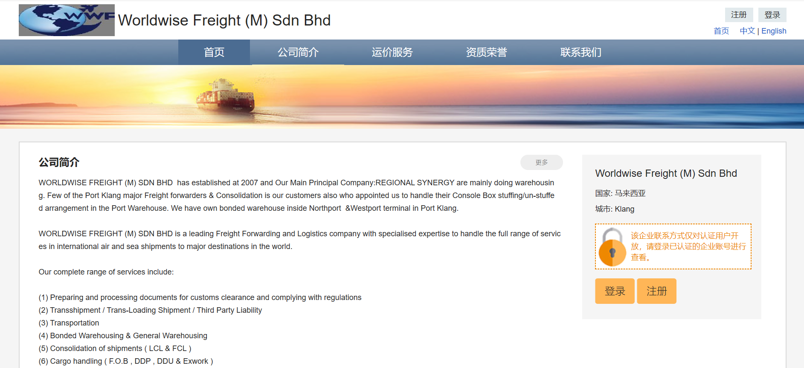
Service Highlights
2) Match business online，help you to expand overseas business：Help enterprises cooperate quickly and contact directly.
Issue cooperation requests，get offer from global agents;
Member enterprise will enjoy one-to-one service，and OLO will help you to find according overseas agents by your business requests;

Slide 9
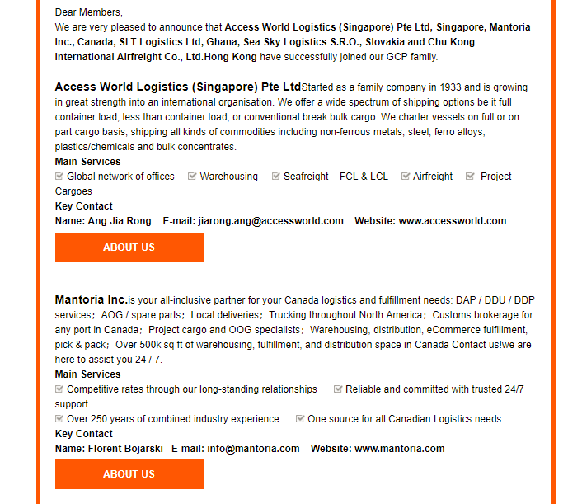
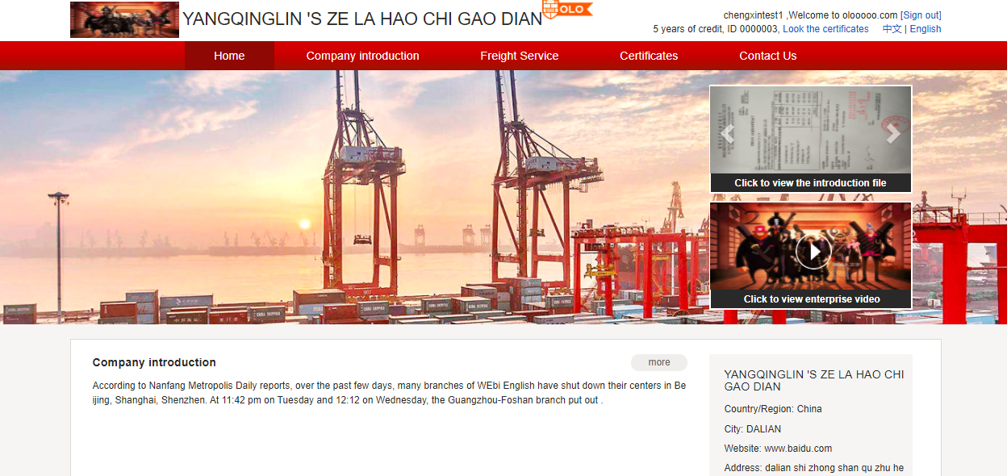
Service Highlights
3) In-depth online promotion channels：Help enterprises to promote their business and brand overseas.
Exclusive English website；
High-traffic banner ；
Group mail, precisely promotion；
Information ranking priority；
Issued information being included by different SE;
Foreign media cooperation、social network promotion

Slide 10
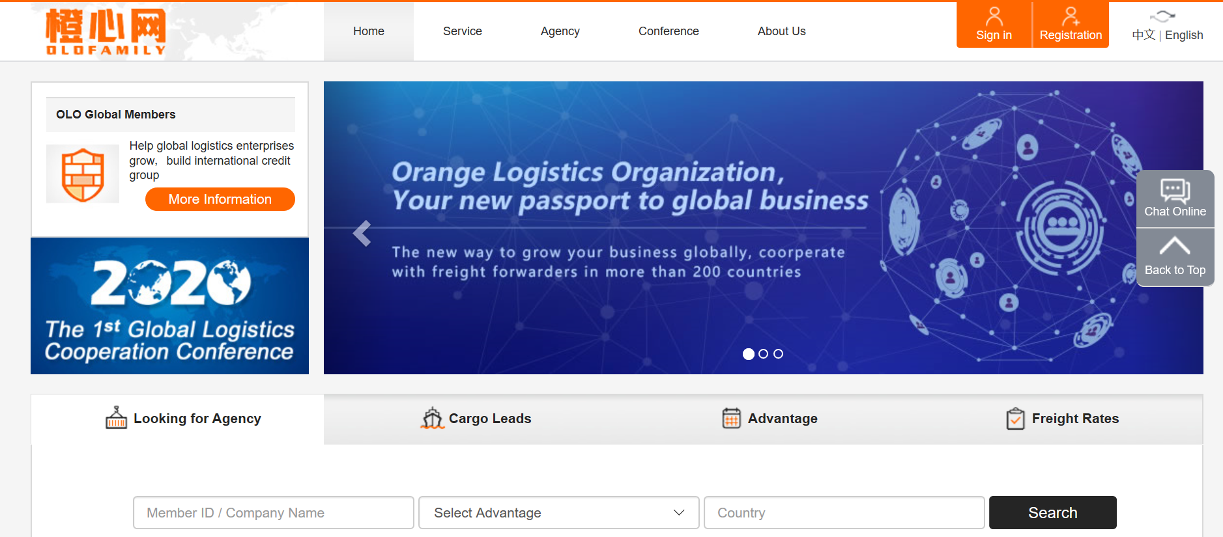
Service Highlights
4) Trade Assurance Services：Assist the new enterprises inside and outside the circle to solve the initial cooperation worries.
100,000USD guarantee per year within OLO membership circle;
5000USD guarantee per year cooperated with the member accepted by OLO;
Joining OLO will be a passport to the world for enterprises.
In case of any disputes happened with other enterprises, OLO staffs will be willing to help and mediate.

Slide 11
Service Highlights
5) Best customer services：OLO sincerely service for you, to be your sincere cooperation partner.
As a part of your enterprise, our professional customer service will help you quickly find the reliable overseas partners by your requests and assist you obtain overseas nomination cargos according to your business advantages.
We are your partner, more willing to be your friend, to help you solve all kinds of problems, and our friendship will last for a long time.

Slide 12
OLO expect to cooperate with you!

